Slide 1


KPI Prediction Tool:
A Look Into The Future
Notes:
Good morning everyone, I hope you are all well rested. Our team is working with Critical Mass on a KPI Prediction Tool: A Look Into The Future

Slide 2

Team Information
Feyre Gezahegn
Report Lead
Wes Warman
Project Lead
Muhammad Khan
Engineering Lead
Saul Chirinos
Data Lead
Yutong Liu
Modeling Lead
Notes:
Feyre:
The CM team (a.k.a Team 4) includes undergraduate and graduate students from a diverse academic discipline.
The team is made up of 5 people:
Feyre Gezahegn -> as the Report Lead;
Wes Warman -> as the Project Lead;
Muhammad Khan -> as the Engineering Lead;
Saul Chrinos -> as the Data Lead; &
Yutong Liu -> as the Modelling lead

Slide 3

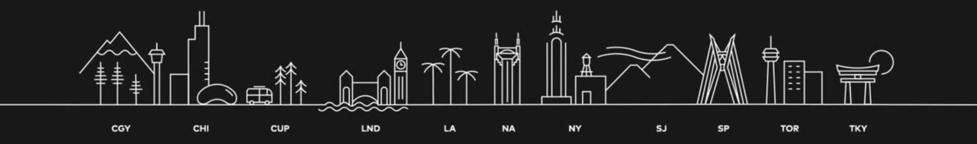
A ‘digital experience design agency’ founded in Calgary.
Global
Strategic
Experienced
Notes:
Wes
Give a brief description of our project partner (CM)
-> Who is CM? What do they do? Where is their HQ based in?
Operated for 25 years
Is global.
Uses data science and human expertise to optimize marketing for clients.

Slide 4
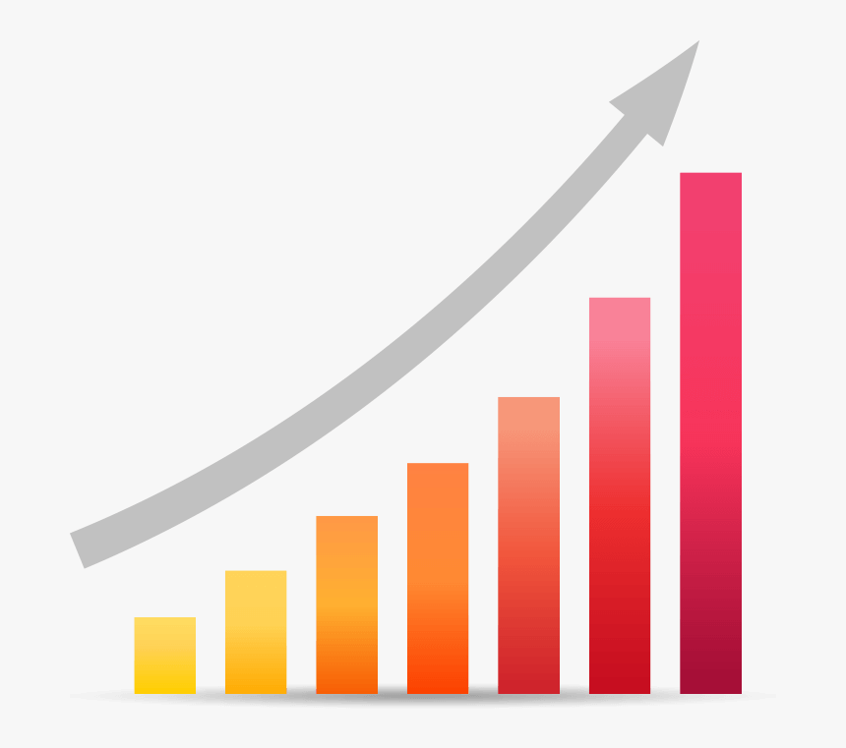


Motivation/Objective
Build a predictive tool to forecast ‘Key Performance Indicators’ for new creatives
Improve the current ability to optimize marketing strategy
Identify most important features of creatives
Notes:
Feyre
The main objective of the project is
To build a machine learning tool to forecast KPIs (Key performance indicators) for new creatives that’ll be launched in the market.
**However, Please note that although the project’s focus is on using the predictive type of KPIs, there are multiple types of KPIs out there.**
Identify most important features of creatives &
Improve the current ability to optimize marketing strategy

Slide 5
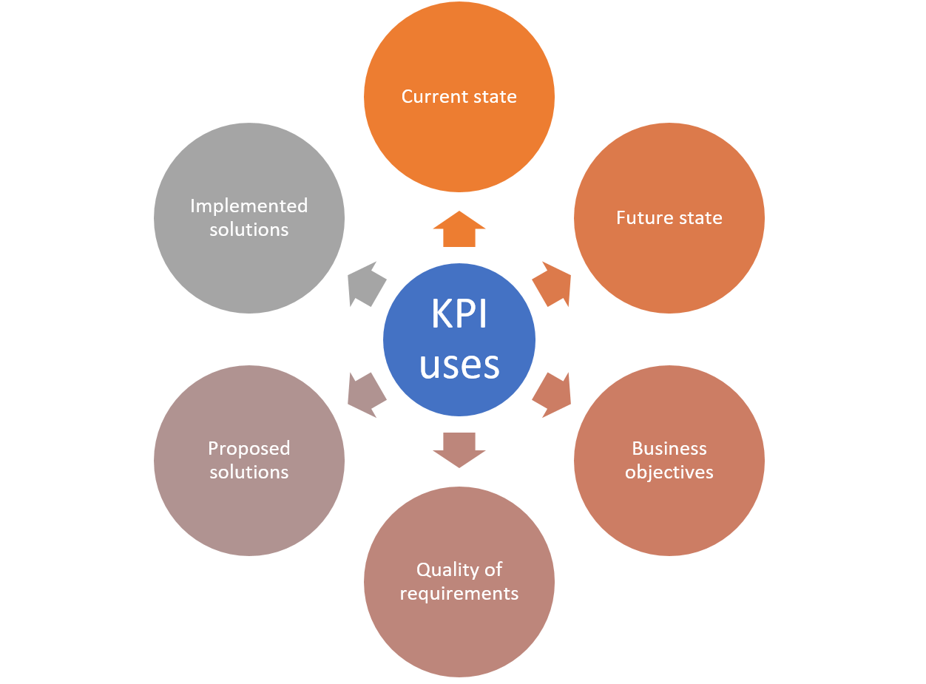
TYPES & USE of KPI
Process KPI
Input KPI
Output KPI
Leading KPI
Lagging KPI
Outcome KPI
Qualitative KPI
Quantitative KPI
Notes:
Feyre
If you take a look at the left side you can see the various types of KPIs including qualitative and quantitative.
If you focus your attention to the visual on the right hand side you can see the various uses of KPI including to determine the current or future state of a project/business.

Slide 6
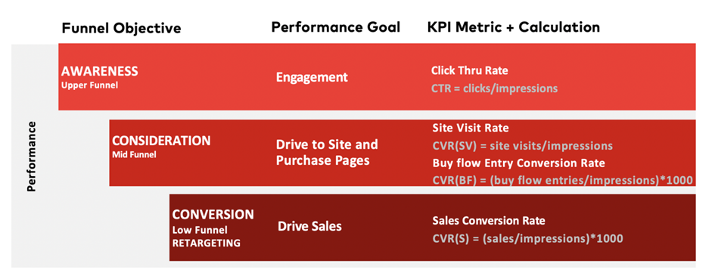
Notes:
Feyre
Each of our permanence indicator is linked to a specific funnel . As you can see the funnel is divided into 3 parts.
First, the upper funnel, here consumers became ‘aware’, and engage with the company.
Second, we have the mid funnel, where consumers actually ‘consider’ the company (this can be done by exploring the products offered by the company on their website)
Finally, there is the low funnel, which is the ‘conversion’ phase, at this point consumers purchase products from the company.

Slide 7
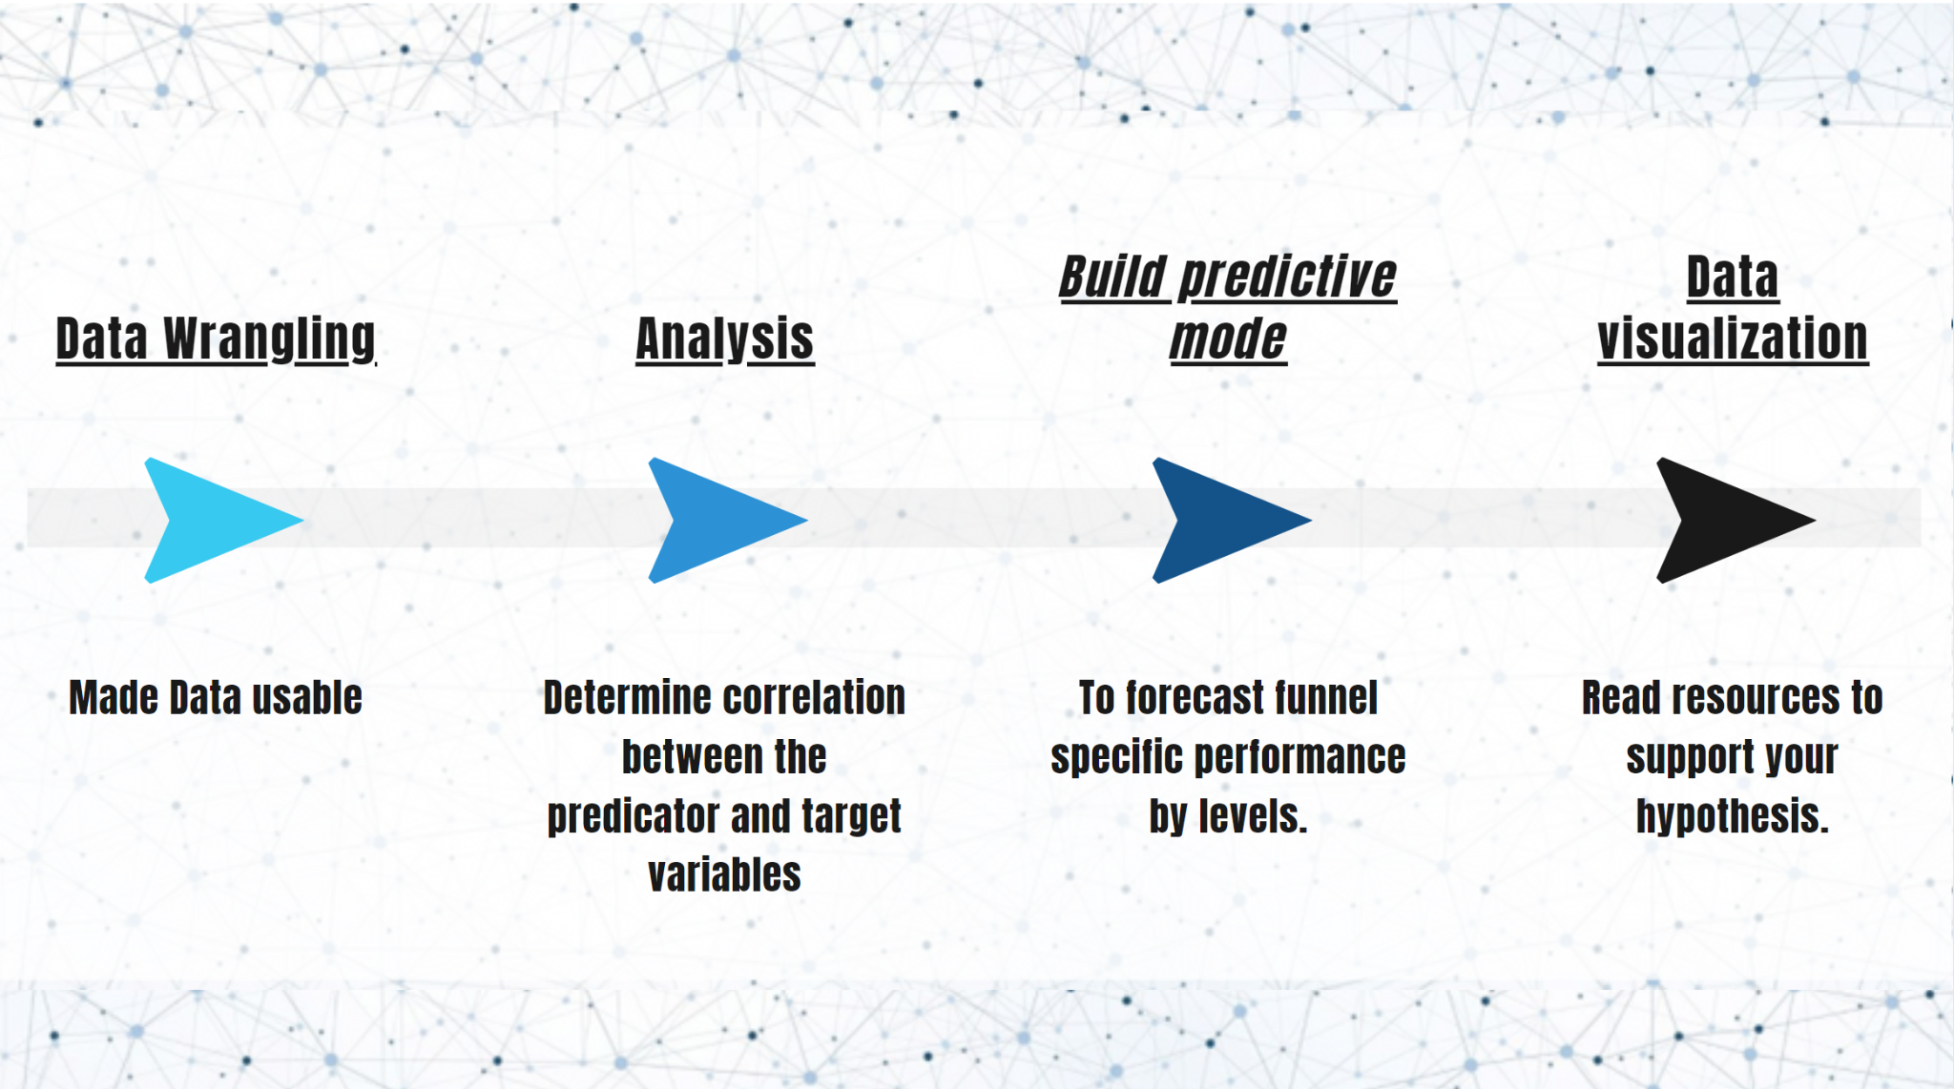
Task division
Notes:
Feyre
The task is divided into 4 parts:
First, we will start by data wrangling and transforming the given dataset to make it usable for our models on various data which will feature software engineering.
Secondly, an analysis will be conducted to determine correlation between the predictor and target variables.
Third, build a predictive model to forecast funnel specific performance by the levels.
Lastly, data visualization, allows usable tools and user interface to plug different inputs and visualize corresponding KPI.

Slide 8
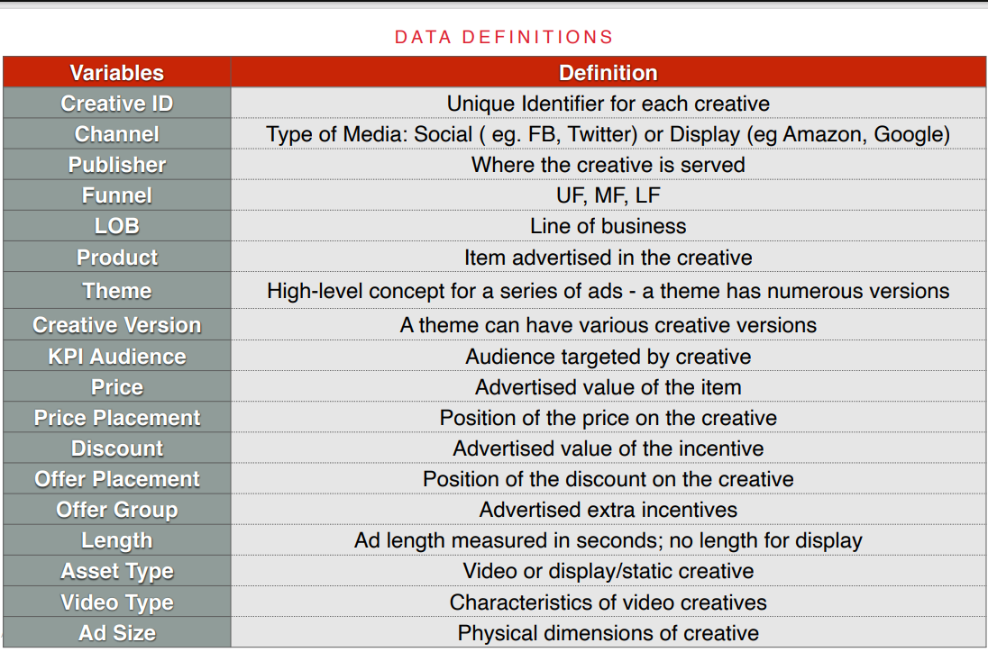
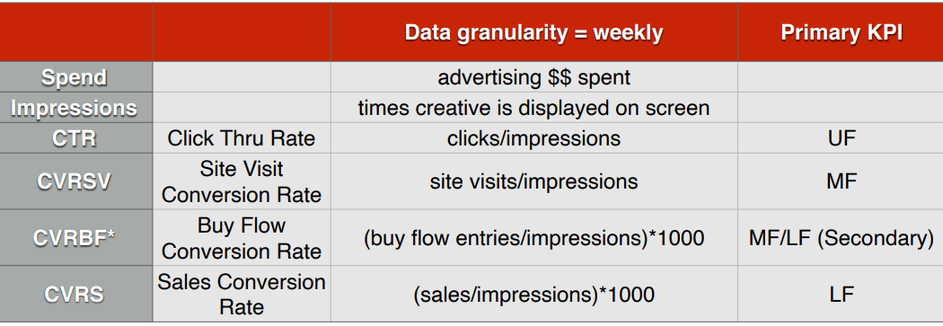
Data
Panel data
Observations: 13,271
Features: 18
Weekly data from Dec 30, 2019 - Dec 27, 2021
Key Performance Indicators (KPI)

Slide 9


Prototype Description
Algorithm Design
Model 1: Benchmark
Model 2
Model 3+
Graphical User Interface (GUI)
Scalability and design
Integration
Notes:
-Saul
For our main algorithm, we will potentially use three models, with the first one being a simple benchmark model and the rest increasing in model complexity. Before selecting our models, we need to get a better understanding of the data. That is, we need to perform exploratory data analysis to identify characteristics of the data, such as variable distributions, correlations, etc. Something else we need to keep in mind is, do we want a model that can predict all KPIs or do we want one model for each funnel that predicts the corresponding KPIs. We’ll need to experiment with that. Once we have our models, we will train and test them to quantitatively measure model performance. Is the model over/under fitting, is the accuracy what we expected, etc. As for the user interface, we think Tableau is our best option because it can hold lots of data, its visually appealing, and it can be integrated with CM smoothly since they prefer Tableau as the interface.

Slide 10
Pathway to Success
Feature Engineering
Model Training
Data Wrangling
Build Prototype
Create User Interface
Notes:
This is our pathway to success roadmap. The first step is to perform data wrangling, which could mean cleaning the data, manipulating the data, transforming the data, etc. Next is feature engineering new variables from existing variables. For example, if you have price and quantity, you can make a new variable called price per quantity. Then we build our prototype models, train and tune them, and select the best performing model. This road map may need to be reiterated multiple times for experimentation of new models and features. Once we have our final, best performing model, we will put it into production and integrate it with Tableau.

Slide 11
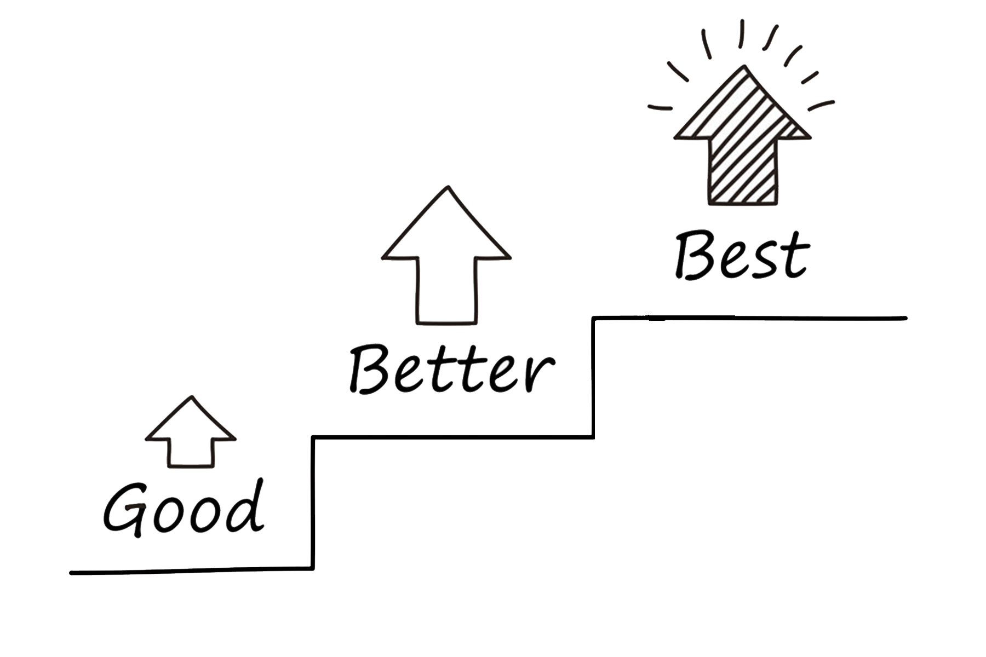

3 Reach Goals:
Build a working and user friendly GUI
Further explore other variables outside of the dataset
Improve the efficiency of the model
Notes:
Muhammad
Build a working and user friendly GUI that will let the user explore visualised data and input different datasets.
Further explore the different variables in the dataset that were not previously considered
Improve the efficiency of the model

Slide 12

Any Questions

Slide 13

Thank You! Join the applaud :)

